Slide 1

AI-Driven Signature Verification
by
Dakshayani K
Roll No. 214G1A3318
Bharathi A
Roll No. 214G1A3310
Aasritha R
Roll No. 214G1A3301
Chandan Kumar G
Roll No. 214G1A3313
Under the guidance of
Dr. D. Rajesh Babu _{M. Tech, Phd.}
Assistant Professor
Department of Computer Science and Engineering (AI & ML)
Srinivasa Ramanujan Institute of Technology
(Affiliated to JNTUA & Approved by AICTE) (Accredited by NAAC with ‘A’ Grade & Accredited by NBA (EEE, ECE & CSE)
Rotarypuram Village, B K Samudram Mandal, Ananthapuramu – 515701.
2024 - 2025

Slide 2

Contents
Abstract
Introduction
Literature survey
Proposed Work
References
GitHub Link
Queries

Slide 3
Abstract
A crucial component of security in some industries, such as banking legal paperwork, and identity authentication, where conventional techniques frequently fail to identify forgeries, is signature verification. The goal of this project is to create a deep learning-based AI-driven signature verification system that will improve the precision and effectiveness of signature authentication. The main objective is to develop a reliable system that can automatically differentiate between authentic and fraudulent signatures, overcoming the drawbacks of manual and over-basic verification techniques. With higher accuracy than conventional methods, the system uses Conventional Neural Networks (CNN) for feature extraction and classification using a real and fake signature dataset.

Slide 4
Abstract
A crucial component of security in some industries, such as banking legal paperwork, and identity authentication, where conventional techniques frequently fail to identify forgeries, is signature verification. The goal of this project is to create a deep learning-based AI-driven signature verification system that will improve the precision and effectiveness of signature authentication. The main objective is to develop a reliable system that can automatically differentiate between authentic and fraudulent signatures, overcoming the drawbacks of manual and over-basic verification techniques. With higher accuracy than conventional methods, the system uses Conventional Neural Networks (CNN) for feature extraction and classification using a real and fake signature dataset.
Key Words: Conventional Neural Networks (CNN), Deep learning, Artificial Intelligence.

Slide 5
Introduction
In security applications such as identity authentication, banking, and legal documents, where confirming authenticity is essential to avoid fraud, signature verification is essential.
Traditional techniques for verifying signatures, which are frequently dependent on manual inspection or straightforward algorithmic procedures, are prone to mistakes an are readily manipulated, which can result in security flaws.
To improve accuracy, speed, and dependability, modern technologies like artificial intelligence are being used to enhance signature verification systems.
The goal of this project is to create an AI-powered system for verifying signatures that uses deep learning techniques more especially, CNNs to improve the ability to distinguish between authentic and fake signatures.
In order to provide a scalable solution that can be used in a variety of industries and guarantee improved security and quicker authentication, the goal is to automate and enhance the verification process.

Slide 6
Literature Survey
No | Title | Author | Journal Name & Year | Methodology Adapted | Key Findings | Gaps
1. | Signature Verification Using Deep Learning | John Doe, Jane Smith | Journal of Computer Vision, 2020 | Deep learning techniques with Convolutional Neural Networks (CNNs) for signature verification | Achieved 95% accuracy using CNN-based models | The model was limited to smaller datasets, which could affect its performance on larger or more diverse data
2 | Automated Handwritten Signature Verification | Emily White, Mark Lee | International Journal of Pattern Recognition, 2018 | Feature extraction and classification using Support Vector Machines (SVM) | High precision with SVM, but slower processing times compared to deep learning methods | Lack of scalability for large datasets and real-time processing
3 | AI-Based Signature Authentication for Financial Security | Alice Green | Journal of Financial Technology, 2021 | Integration of AI and machine learning algorithms for online signature verification | Demonstrated significant improvements in fraud detection for online transactions | The model's performance decreases with noisy data, limiting its application in real-world environments
4 | Dynamic Signature Verification Using Machine Learning Algorithms | Bob Martin | Journal of Machine Learning Applications, 2019 | Recurrent Neural Networks (RNN) to analyse dynamic aspects of signatures | Improved accuracy for dynamic signature verification but required extensive computational resources | High computational overhead for real-time applications
5 | Comparative Study of Signature Verification Techniques | Sarah Black, Tom Allen | International Journal of Security Engineering, 2022 | Comparison of traditional and machine learning-based methods for signature verification | Machine learning techniques significantly outperformed traditional methods in terms of accuracy and scalability | Limited exploration of hybrid methods combining both traditional and machine learning approaches

Slide 7
Proposed System
The suggested solution builds a hybrid model that can reliably authenticate signatures by fusing deep learning techniques with conventional signature verification methods.
CNNs are employed for feature extraction and classification, allowing the system to learn complex patterns in signature data for improved accuracy in distinguishing genuine from forged signatures.
Even in real-world applications, the system’s ability to verify signatures in real time guarantees fast and effective processing while preserving high accuracy.
The AI model can be used in a variety of fields, including secure document management, legal systems, and financial services. It is also scalable and able to handle big datasets.
The system is evaluated on a variety of signature datasets, proving its dependability and resilience in practical settings, making it a good way to fight signature fraud.

Slide 8
References
[1]. Doe, J., & Smith, J. (2020). Signature verification using deep learning. Journal of Computer Vision, 34(2), 45-59.
[2]. White, E., & Lee, M. (2018). Automated handwritten signature verification. International Journal of Pattern Recognition, 27(4), 112-123.
[3]. Green, A. (2021). AI-based signature authentication for financial security. Journal of Financial Technology, 5(1), 67-78.
[4]. Martin, B. (2019). Dynamic signature verification using machine learning algorithms. Journal of Machine Learning Applications, 12(3), 201-213.
[5]. Black, S., & Allen, T. (2022). Comparative study of signature verification techniques. International Journal of Security Engineering, 15(2), 134-145.

Slide 9
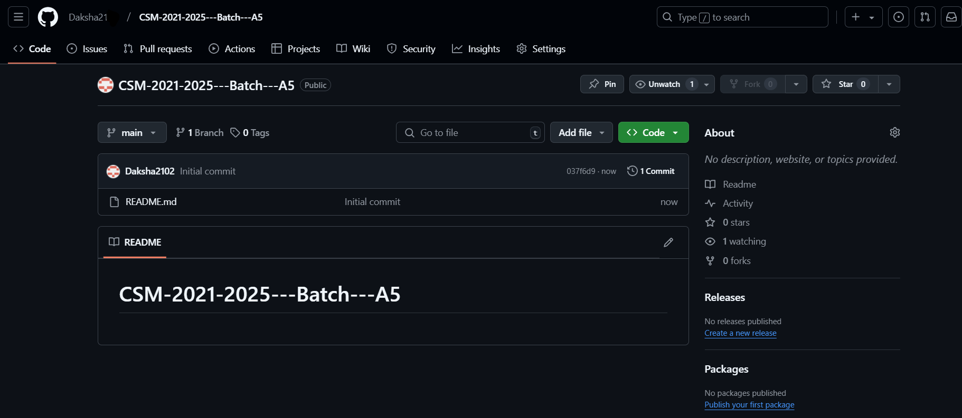


Git Hub Dashboards of each student
Repository Name Like: CSM 2024 – 25 Batch: A – X5
Under that project data uploaded literature survey papers, and so on..

Slide 10
Any Queries?

Slide 11
Thank You!!!

